Slide 1
Language Agent Tree Search (LATS) Unifying Reasoning, Acting, and Planning in Language Models
Presented by Group 4

Slide 2
Outline
Introduction
Related Work
LATS Framework Overview
Experimental Results
Ablation & Efficiency Analysis
Conclusions & Future Work

Slide 3
Introduction
What is Language Agent Tree Search (LATS)?
LATS is a unified framework that enables language models to reason, act, and plan.
Why it matters?
LATS enhances decision-making by integrating external feedback with reasoning, action, and planning, overcoming the limitations of current prompting techniques.

Slide 4
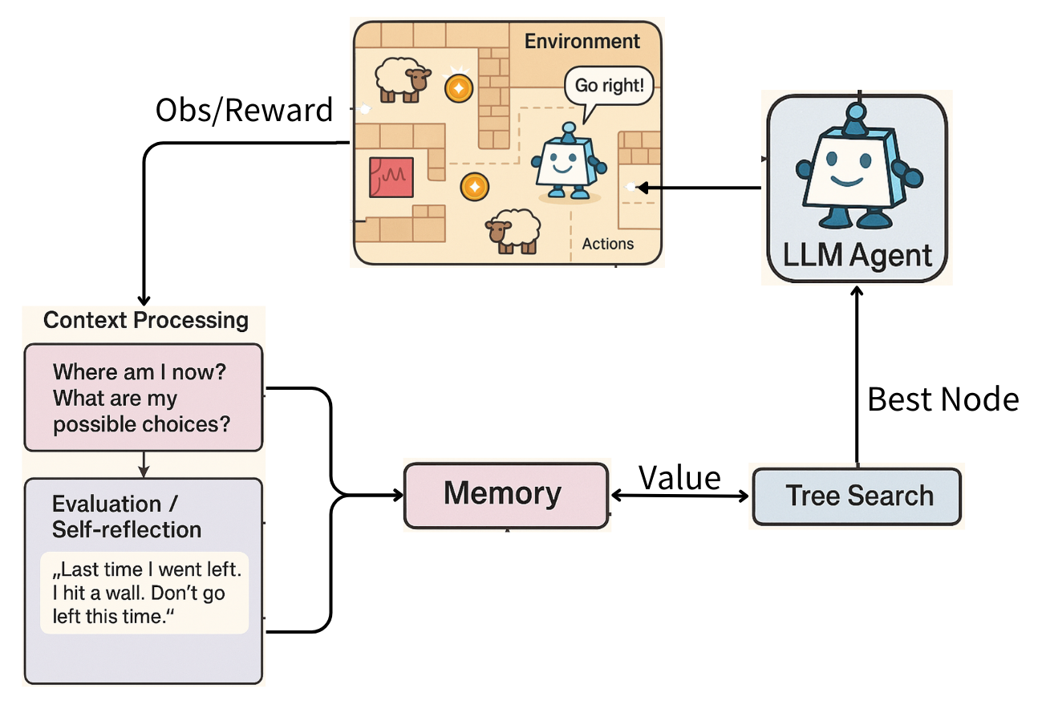

Slide 5
Related Work
LMs for reasoning
Language models reason by breaking down complex problems into sequential steps.
Shortcomes
suffer from error propagation as the number of reasoning steps increases by compound errors.

Slide 6
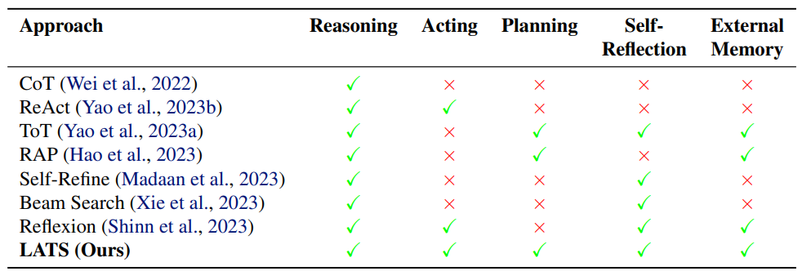
Solution
self-consistency
use majority voting over multiple reasoning chains, while others adopt
least-to-most prompting
multi-step decomposition

Slide 7
Improve - Search Algorithms
Tree-of-Thought (ToT)
prompting uses depth- or breadth-first search guided by LM-generated heuristics.
Reasoning via Planning (RAP)
applies Monte Carlo Tree Search (MCTS), with the LM simulating future steps (rollouts).

Slide 8
Limitation
cannot self-correct their internal reasoning, making it critical to use external feedback.

Slide 9
LMs for acting
ReAct (Reason + Act)
Combines thoughts and actions in context
Limitations
Struggles with dynamic environments
Cannot explore alternative actions at each step
Enhancement Methods
Self-Refine, Reflexion, AdaPlanner

Slide 10
Weakness of previous prompting framework
Flexibility(neglecting potential path)
example: CoT or ReAct
Sensibility(no external observations)
example: CoT, RAP or ToT
Adaptability
example: ToT (simple search algorithms)
RAP (MC+LM predict states)

Slide 11
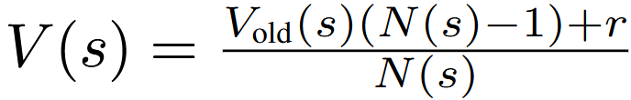
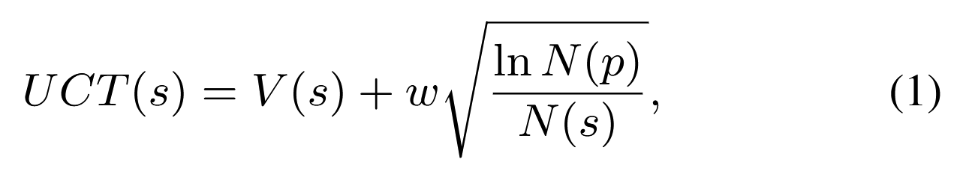
Monte Carlo Tree Search (MCTS)
Node value update formula
UCT (Upper Confidence bounds applied to Trees)

Slide 12
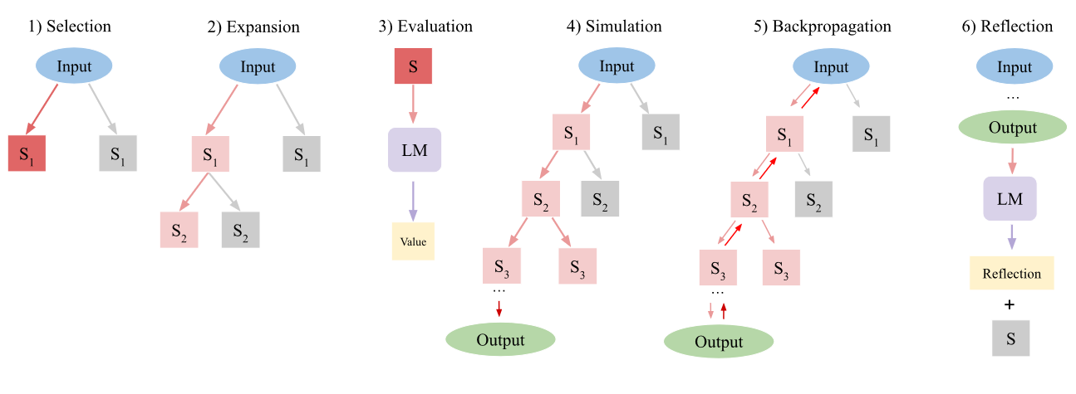


LATS Framework Overview
Selection | Expansion | Evaluation | Simulation | BP | Reflection
 |  |  | try to terminal node | return reward | generate reflect prompt
Notes:
1.使用 UCT（Upper Confidence Bound）演算法計算每個節點的探索價值，從根節點開始一路往下挑選分支節點
2.在剛剛選中的葉節點中，讓語言模型生成 n 個可能的動作。結果？：這些動作被送進環境執行，環境會回傳對應的觀察（Observation），產生新的子節點。 樹的變化？：原本的葉節點現在變成內部節點，新生成的子節點被加入到搜尋樹中。
3. 使用語言模型自我評估這個狀態的好壞（LM Score）結合自我一致性（Self-Consistency）：如果多次抽樣都出現相同動作，代表這個動作較可靠
4. 從目前的節點繼續往下推演（走訪）節點，直到遇到一個「終端節點（terminal node）」：
5. 將剛剛模擬完成後的 reward（環境給的成功或失敗分數）沿著這條路徑向上回傳，更新所有中間節點的 V 值與訪問次數。
6. 如果這次模擬是「失敗」的，語言模型會根據這條錯誤路徑與 reward，自動生成一段 反思文字。

Slide 13
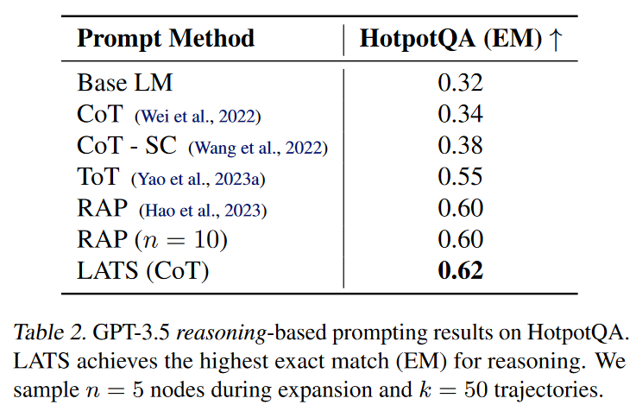
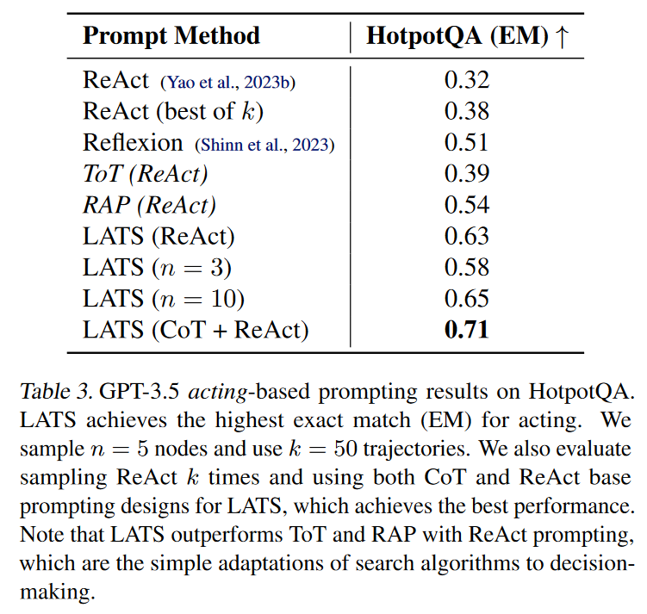
Experimental Results
HotPotQA - multi-hop question-answering benchmark
LATS（CoT）- LATS with CoT prompt.
LATS（CoT）- LATS using CoT prompt first, and then switching to ReAct prompt when upon failure.
Notes:
HotPotQA is a multi-hop question answering dataset, where each question requires retrieving information from multiple articles to identify relevant passages and reason out the answer. To compare with methods like CoT and ToT, this paper removes the Action and Observation information from the context to implement a CoT version of LATS. the results show that even without external feedback, LATS still achieves the best performance, so we can see the importance of using Monte Carlo Tree Search.
In addition, this paper compares other acting-based methods on HotPotQA. Therefore, it combines CoT and ReAct by only using ReAct prompts when CoT fails to derive a correct result. According to the results, LATS outperforms other methods, and as the number of nodes increases, the agent’s performance also improves. Notably, the LATS achieves SOTA on HotPotQA.
HotPotQA是一個multi-hop的問答數據集，裏面的每一個問題，都需要透過從多個文章中檢索，找出與答案相關的段落，進而推理出答案。
爲了與CoT、ToT這種依賴模型内部知識的方法比較，本文將LATS上下文中的Action、observation信息刪掉實現了CoT版的LATS，實驗結果顯示，即使在沒有外部反饋的情況下，LATS依然達到了最好的性能，這凸顯了使用蒙特卡羅樹搜索的重要性。
除此之外，本文也在HotpotQA與其他acting-based的方法做比較。因此本文結合了CoT和ReAct，只有在使用CoT得出失敗的結果時，才會使用ReAct的Prompt。根據實驗結果，LATS的性能超過了其他方法，且隨著節點數n的上升，agent的性能也會隨之上升。值得注意的是結合CoT和ReAct版本的LATS在HotPotQA達到了SOTA。

Slide 14
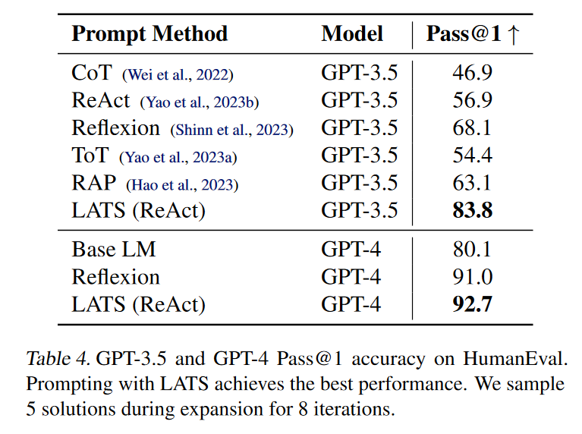
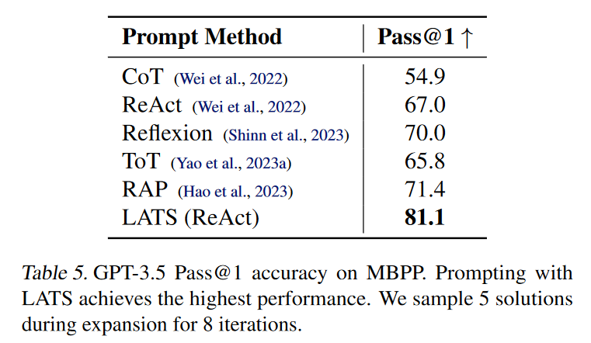
Experimental Results
HumanEval
MBPP
LATS（ReACT）- LATS with ReAct prompt
Notes:
This paper also evaluates LATS's capability in programming tasks. In this test, each solution generated by LATS is treated as part of the action space, while feedback from the test suite and compiler serves as observations. Since LATS directly outputs complete code segments, the simulation phase is skipped in this setting, and the reward is defined as the percentage of passed test cases.
According to Tables 4 and 5, LATS achieves the best performance regardless of whether it is based on GPT-3.5 or GPT-4.
本文同時也測試了LATS在編程的能力，在這項測試中，本文將LATS每次給出的solution作爲Action space，而test suite和編譯器的反饋作爲observation。并且由於LATS會直接輸出整段代碼，因此在這項測試中，LATS會跳過simulation階段，並使用通過的測試用例百分比作爲reward。
根據表4、5我們可以看出不管是基於GPT3.5、和GPT4的模型LATS都能達到最好的性能

Slide 15
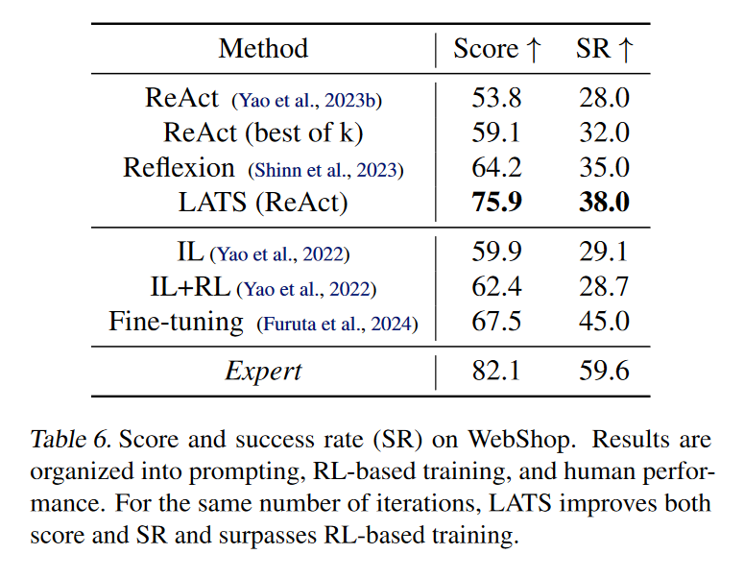
Experimental Results
WebShop
Notes:
For a complex decision-making environment with practical applications, this paper consider WebShop, an online shopping environment composed of a website.
and Agents must navigate a website through a variety of commands to purchase an item matching a user specification.
according to the Table6.
We can observe that LATS outperforms other methods in both Score and SR metric. Notably, LATS not only surpasses other zero-shot method but even outperforms methods based on fine-tuning.
我們可以發現LATS的性能不管是在Score和SR上都超越了其他方法，值得注意的是LATS不僅超過了其他zero-shot方法，甚至强過了基於Fine-tuning的方法。

Slide 16
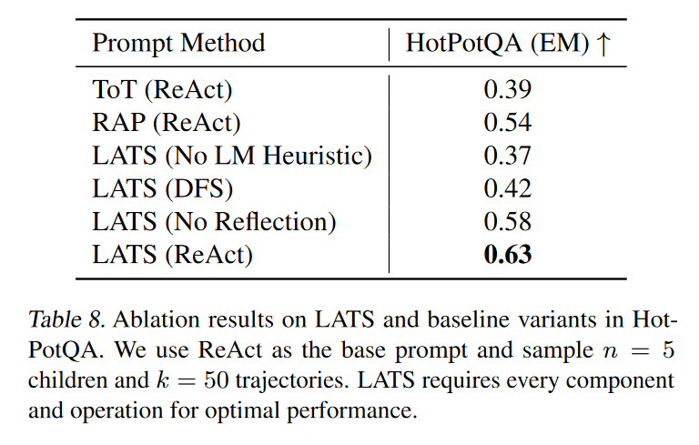
Ablation & Efficiency Analysis
Notes:
爲了驗證LATS每個組件的的有效性，本文針對LATS的每個組件進行了消融實驗，
To verify the effectiveness of each component of LATS, this paper conducts ablation studies on each individual component.
“We find in Tab. 8 (Row 3) , the main component of value function, is crucial for leveraging external feedback and strong performance.”
we also find in Tab. 8(Row 4)“,when LATS using the DFS method, we observe a 0.21 drop in performance”
and In Tab. 8 (Row 5), we observe a 0.05 performance drop when self-reflection is removed from LATS.

Slide 17
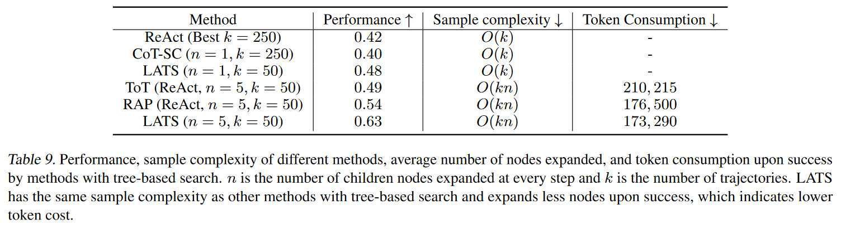
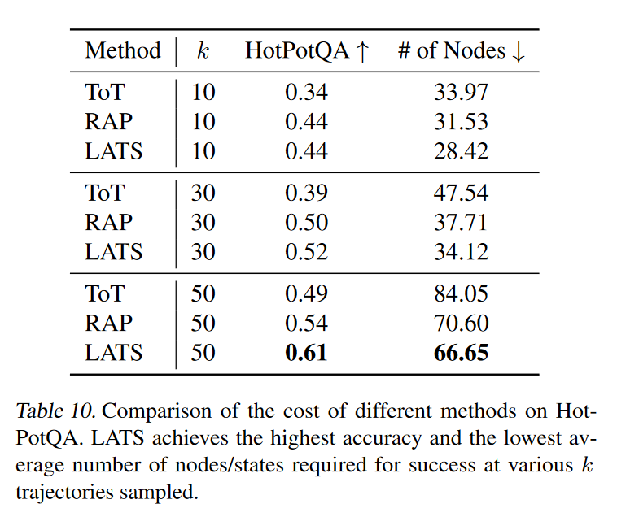
Ablation & Efficiency Analysis
Notes:
Final In Efficiency Analysis parts.
One possible concern of LATS is that the tree-structured search might consume much more tokens than existing methods.
so this paper also examine the sample complexity (i.e., asymptotic token cost) of all methods considered in this paper
result show that LATS has the same sample complexity as other tree-based search methods but requires fewer overall tokens and states.
"This is the end of our report. Thank you, everyone."

Slide 18
Conclusions & Future Work
High computational cost
Although LATS has higher computational cost, it offers several advantages that help offset this. Fewer Node Expansions, Higher Quality, Lower token usage.
Reversible environments required
LATS assumes the ability to backtrack, which may not apply to all settings.
Notes:
Final In Efficiency Analysis parts.
One possible concern of LATS is that the tree-structured search might consume much more tokens than existing methods.
so this paper also examine the sample complexity (i.e., asymptotic token cost) of all methods considered in this paper
result show that LATS has the same sample complexity as other tree-based search methods but requires fewer overall tokens and states.
"This is the end of our report. Thank you, everyone."

Slide 19
Q&A

